Slide 1
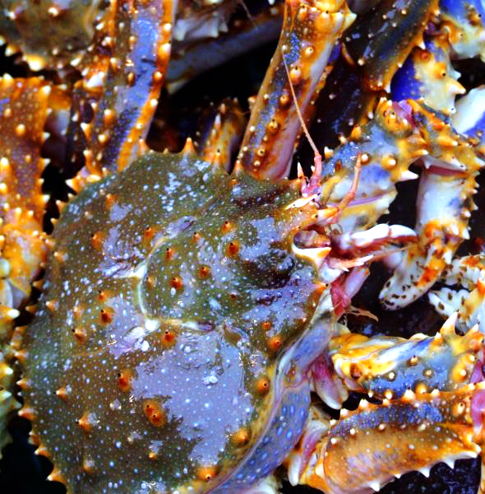
A qualitative modeling approach to assess the potential effects of management interventions and environmental change on Pribilof Islands blue king crab
(Paralithodes platypus)
Jonathan Reum^{1,2}, P. Sean McDonald¹, Kirstin Holsman², Chris Long²,
Janet Armstrong¹, David Armstrong¹
¹University of Washington
²NOAA
email: reumj@uw.edu
Photo credit: Alaska Sea Grant

Slide 2
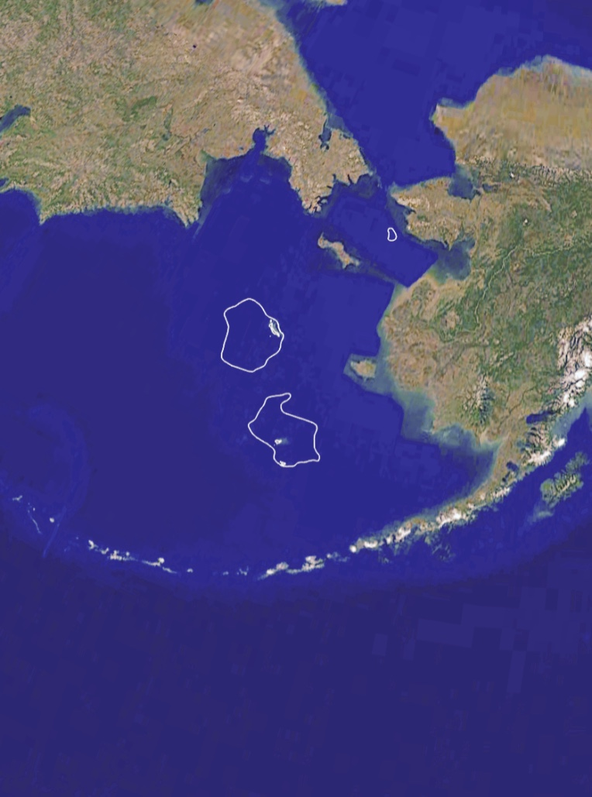
What can we do?
Get into biology ecology more
How much did the fishery bring in?
Since they are low in abundance, strict measures in place to reduce by-catch
Fishery closure
Pribilof Islands
Habitat CA
Catches (t)
SAFE: Stockhausen 2015
Notes:
What was the value of the fishery?
It have strict by-catch limits in other fisheries.

Slide 3
Conceptual models
Qualitative Network models
Notes:
Summarize knowledge
Communication tools
Qualitative predictions
Identify knowledge gaps
Set research objectives

Slide 4
Qualitative
models
Realism
Goals of mathematical modelling
Understand
Predict
Intervene
Generality
Mechanistic
models
Statistical
models
Precision
Levins (1968)

Slide 5
Gives a positive effect

Slide 6
Gives a positive effect
Gives a negative effect
?
?
?

Slide 7

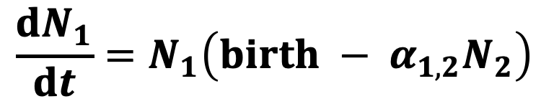
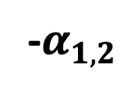
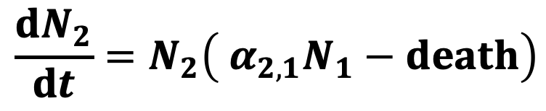
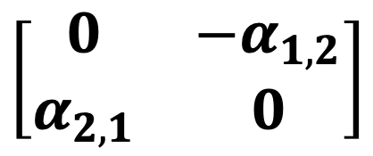
$$\frac{dN_{1}}{dt}=N_{1}\left(birth − α_{1,2}N_{2}\right)$$
$$\frac{dN_{2}}{dt}=N_{2}\left( α_{2,1}N_{1}−death\right)$$
-$α_{1,2}$
Community Matrix
Signed digraph
$$\left[\begin{matrix}0 & −α_{1,2} \\ α_{2,1} & 0\end{matrix}\right]$$
$${+α}_{2,1}$$

Slide 8
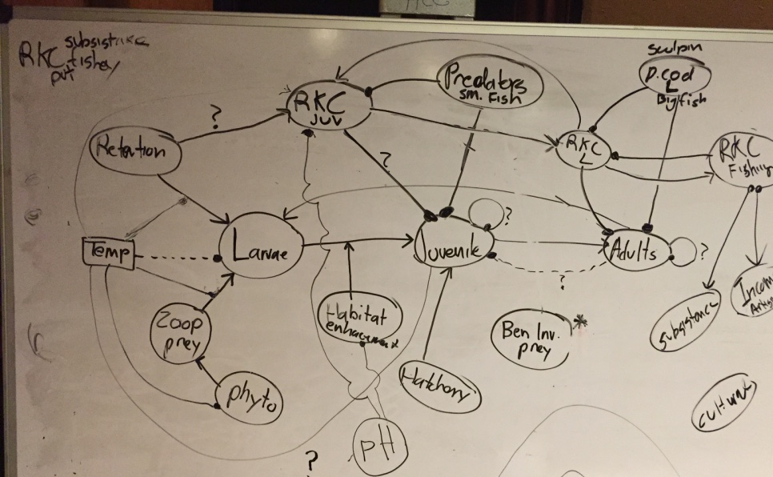
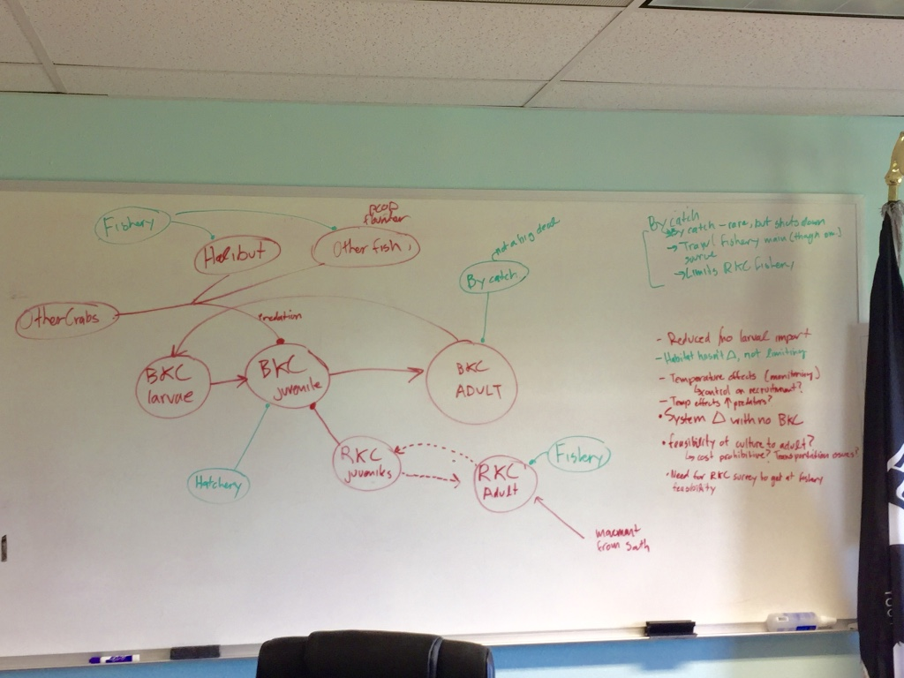
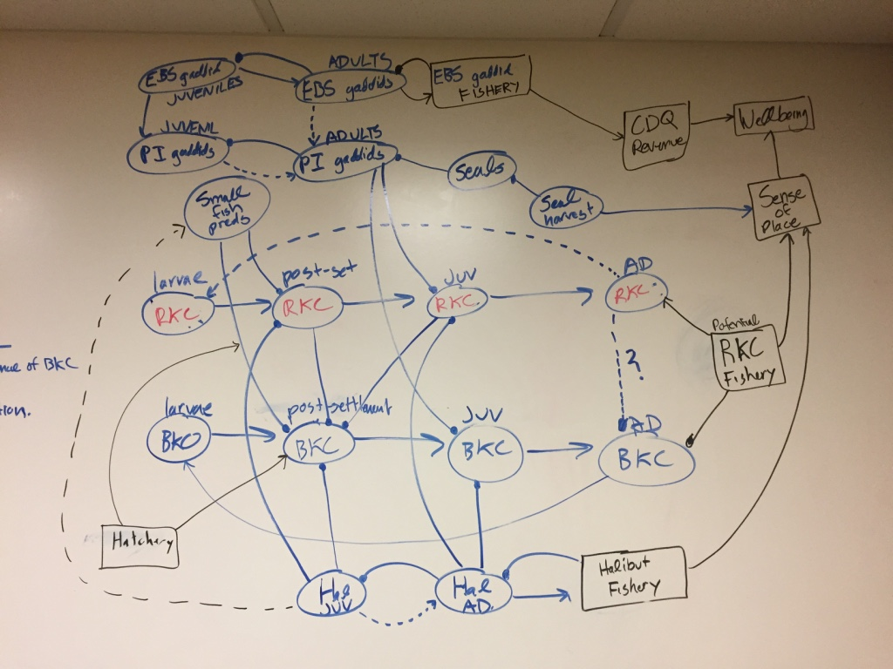
Stakeholder workshops
Ecological
interactions
AMSS 2017
St. Paul
Management levers
Seattle
Climate
impacts
Notes:
Name da peoples

Slide 9
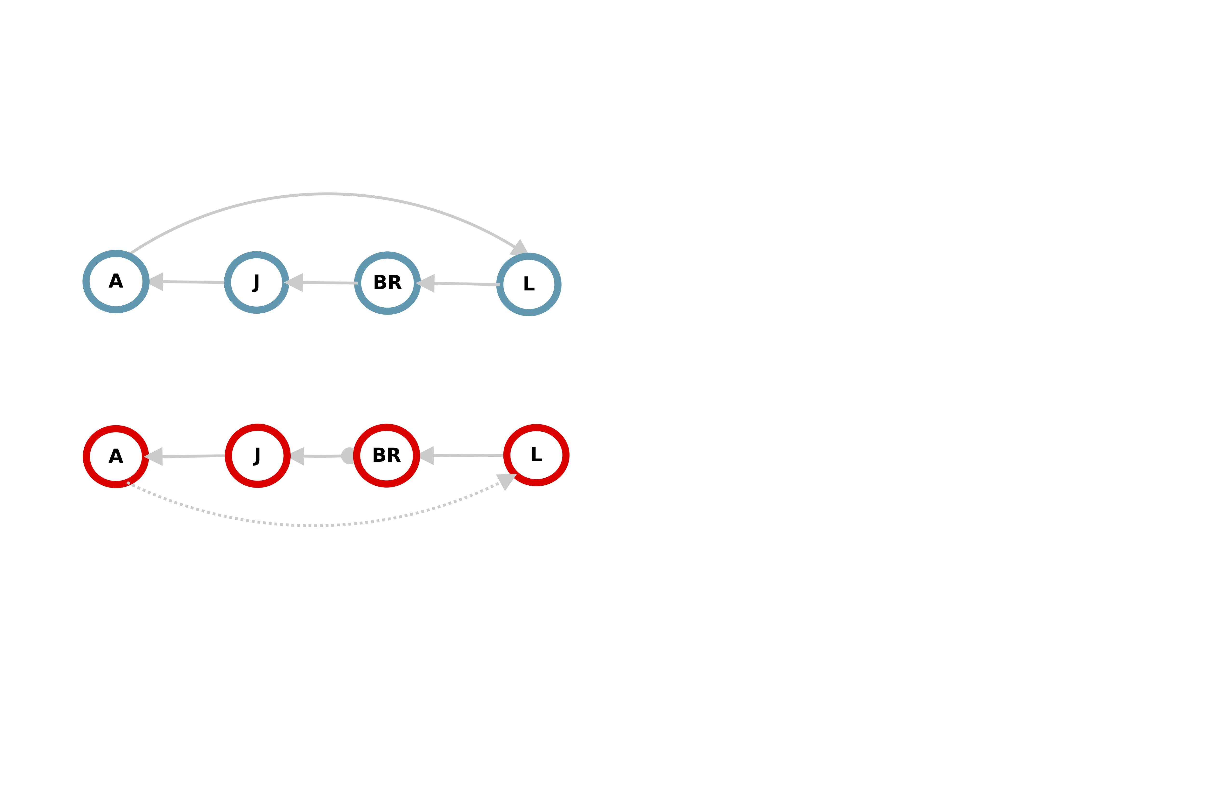
Gives a positive effect
Gives a negative effect

Slide 10
Gives a positive effect
Gives a negative effect

Slide 11
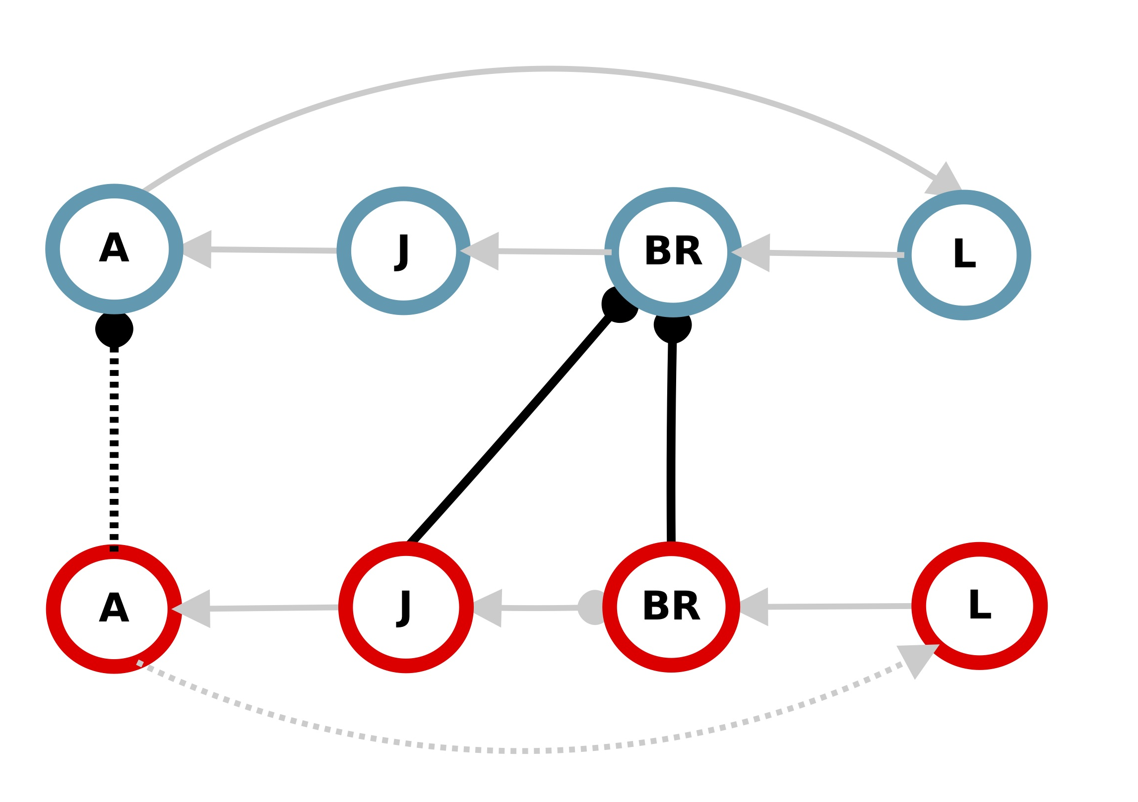
Gives a positive effect
Gives a negative effect
Uncertain existence

Slide 12
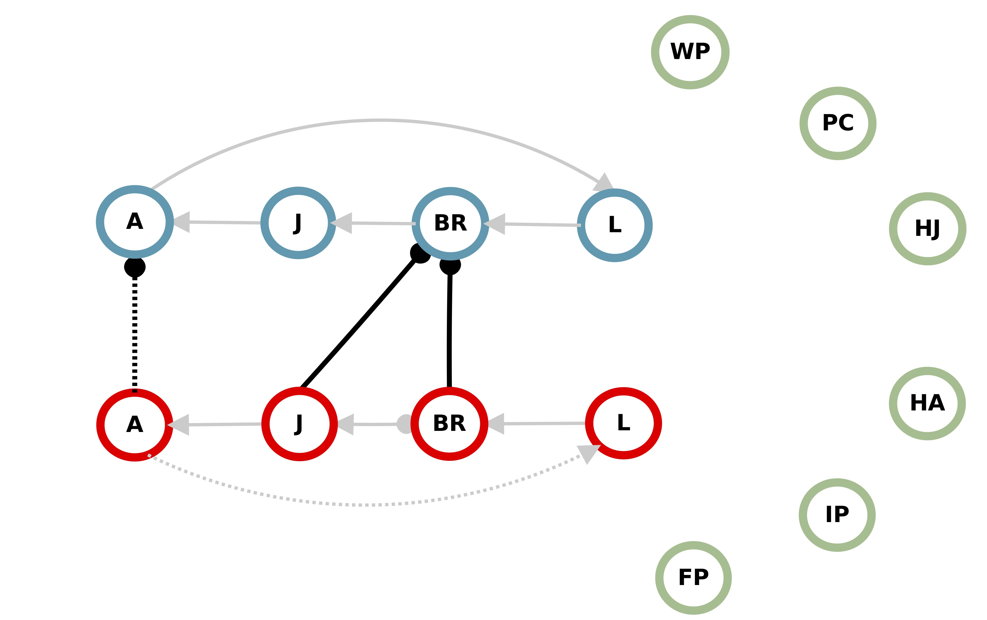
Gives a positive effect
Gives a negative effect
Uncertain existence

Slide 13
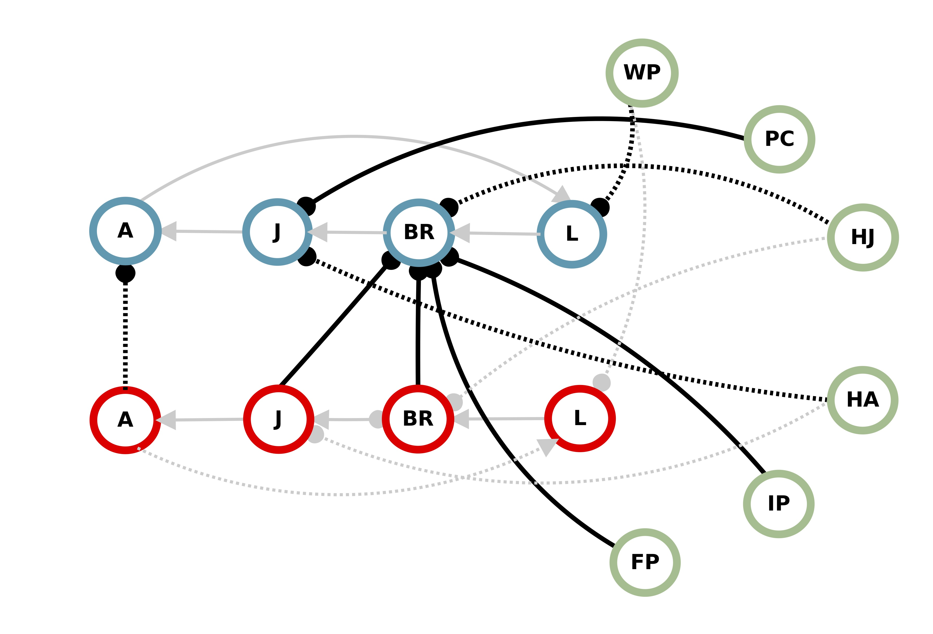
Gives a positive effect
Gives a negative effect
Uncertain existence

Slide 14
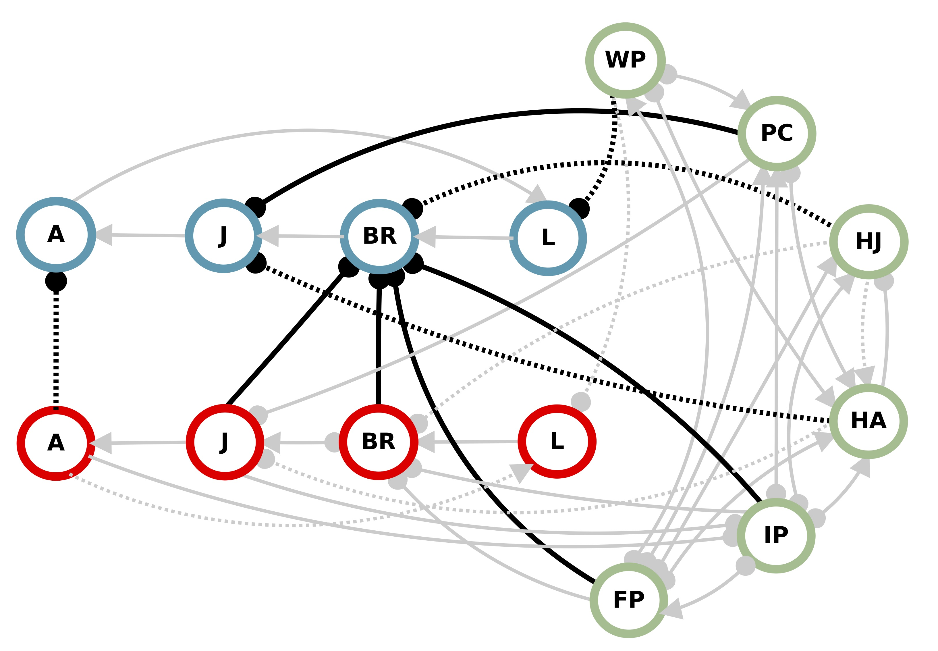
Gives a positive effect
Gives a negative effect
Uncertain existence

Slide 15
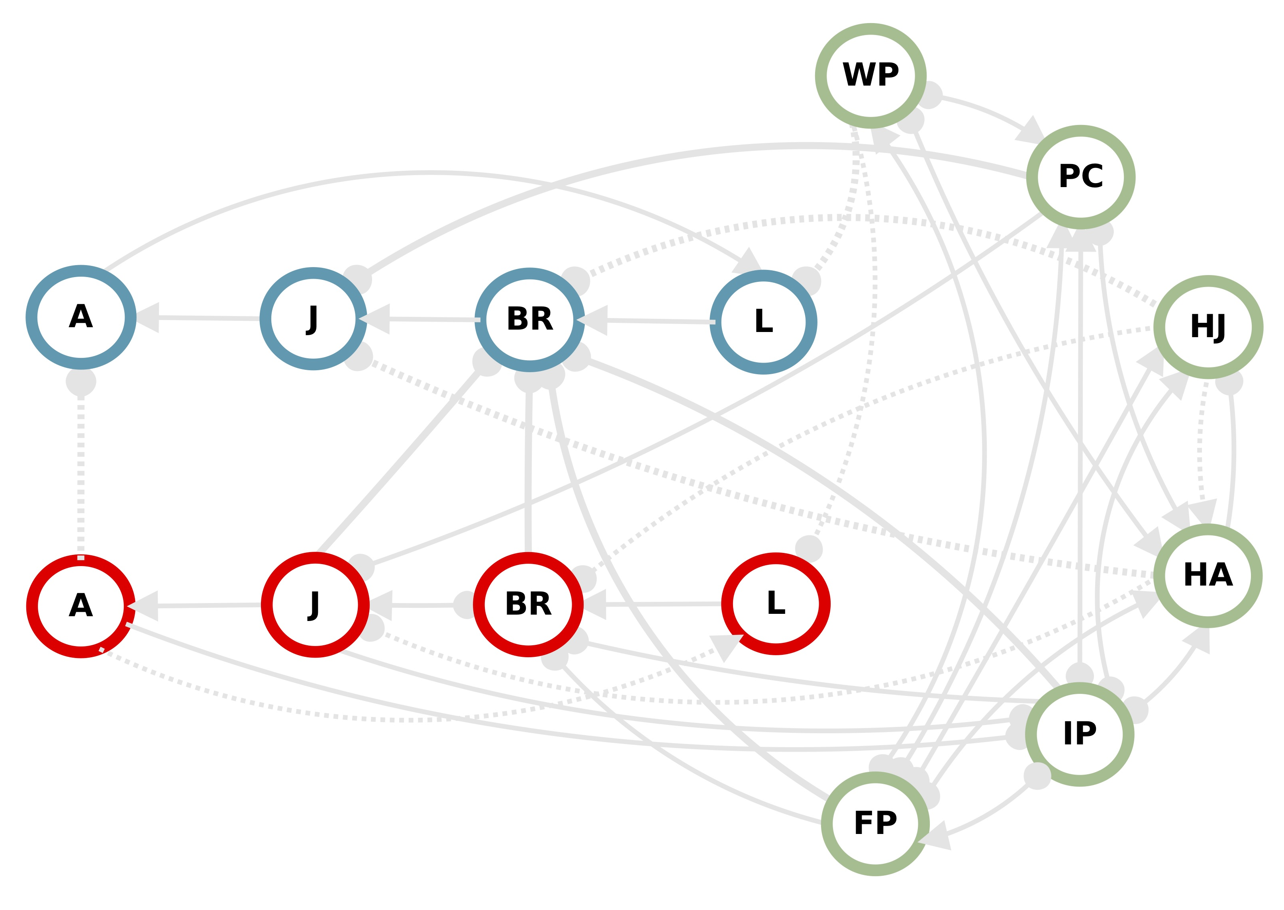
Species
fisheries

Slide 16
Species
fisheries
Fishing
effort
E

Slide 17
-
Warming
-
-
-
W
+
+

Slide 18
Ocean
acidification
-
-
OA
-
-
-

Slide 19
Main scenario summaries

Slide 20
Simulation approach
1. Sample
network
?
-
+
-
2. Weight community
matrix
 | .42 |  | -.05 | .03
-.90
 | -.21 |  | -.83 | -.17
.13 | .76 | .91
-.10 |  |  | -.67
~Uniform(.01, 1)
-
?
-
+
?
+
-
-
3. Inequalities met?
NO
Swap values to comply
YES
4. Test for stability
NO
Discard!
YES
5. Calculate press
Melbourne-Thomas et al. 2012, Ecological Monographs

Slide 21
Simulation approach
?
-
+
-
100
-
?
-
75
Response
+
?
+
% Positive
outcomes
50
-
-
25
0
Pressed node

Slide 23
Adult
Juvenile
Benthic recruit
Larvae
Outcome certainty
Increase
High
Adult
Juvenile
Benthic recruit
Larvae
Moderate
Low
Moderate
Halibut (adult)
Halibut (juvenile)
Walleye pollock
Pacific cod
Sm. Invert. predators
Sm. Fish predators
Decrease
High
Other
species
Pacific cod
Halibut
Red King Crab
Trawl
Fishing
effort
Press
nodes
BKC outstocking
Warming
OA
Management
Climate
Climate &
Management

Slide 24
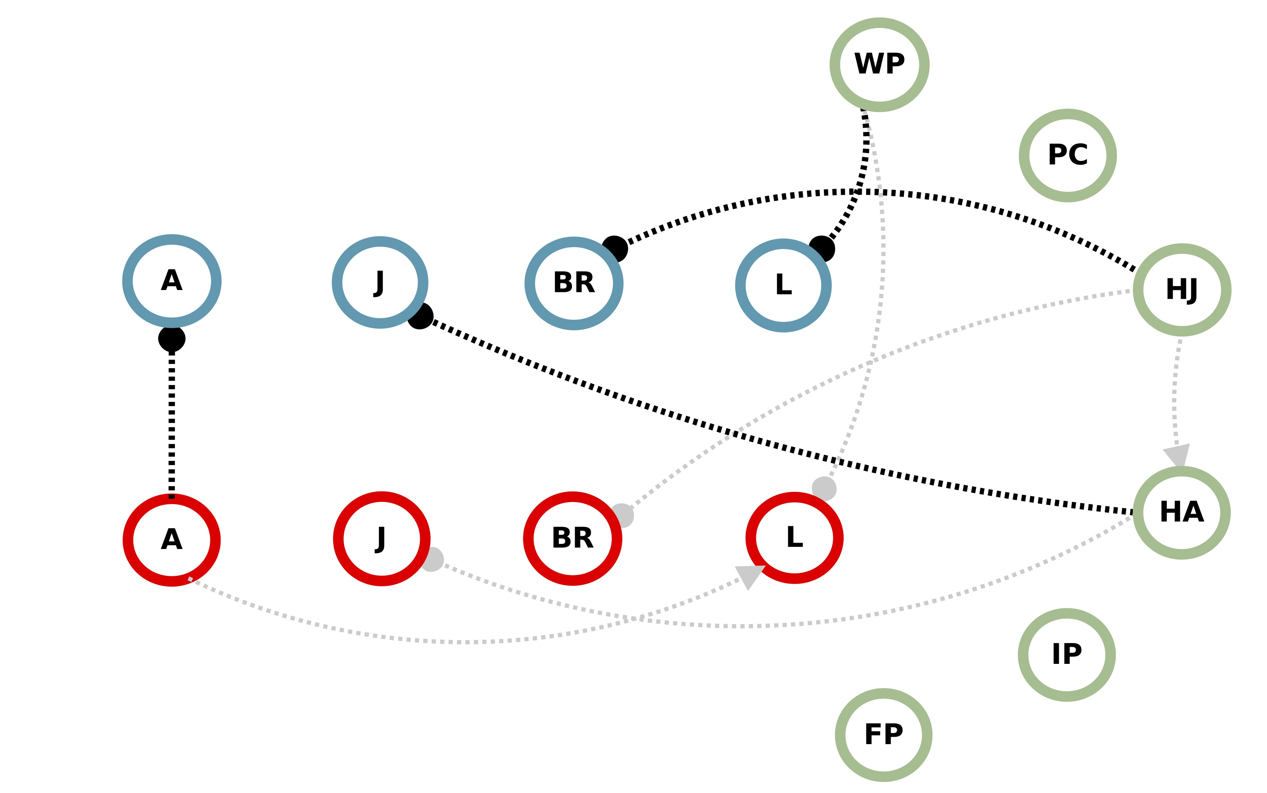

Slide 25
How sensitive are BKC adult outcomes to uncertain links?
Probability of positive response of
Difference
Yes
No
RKC-A BKC-A Link present?

Slide 26
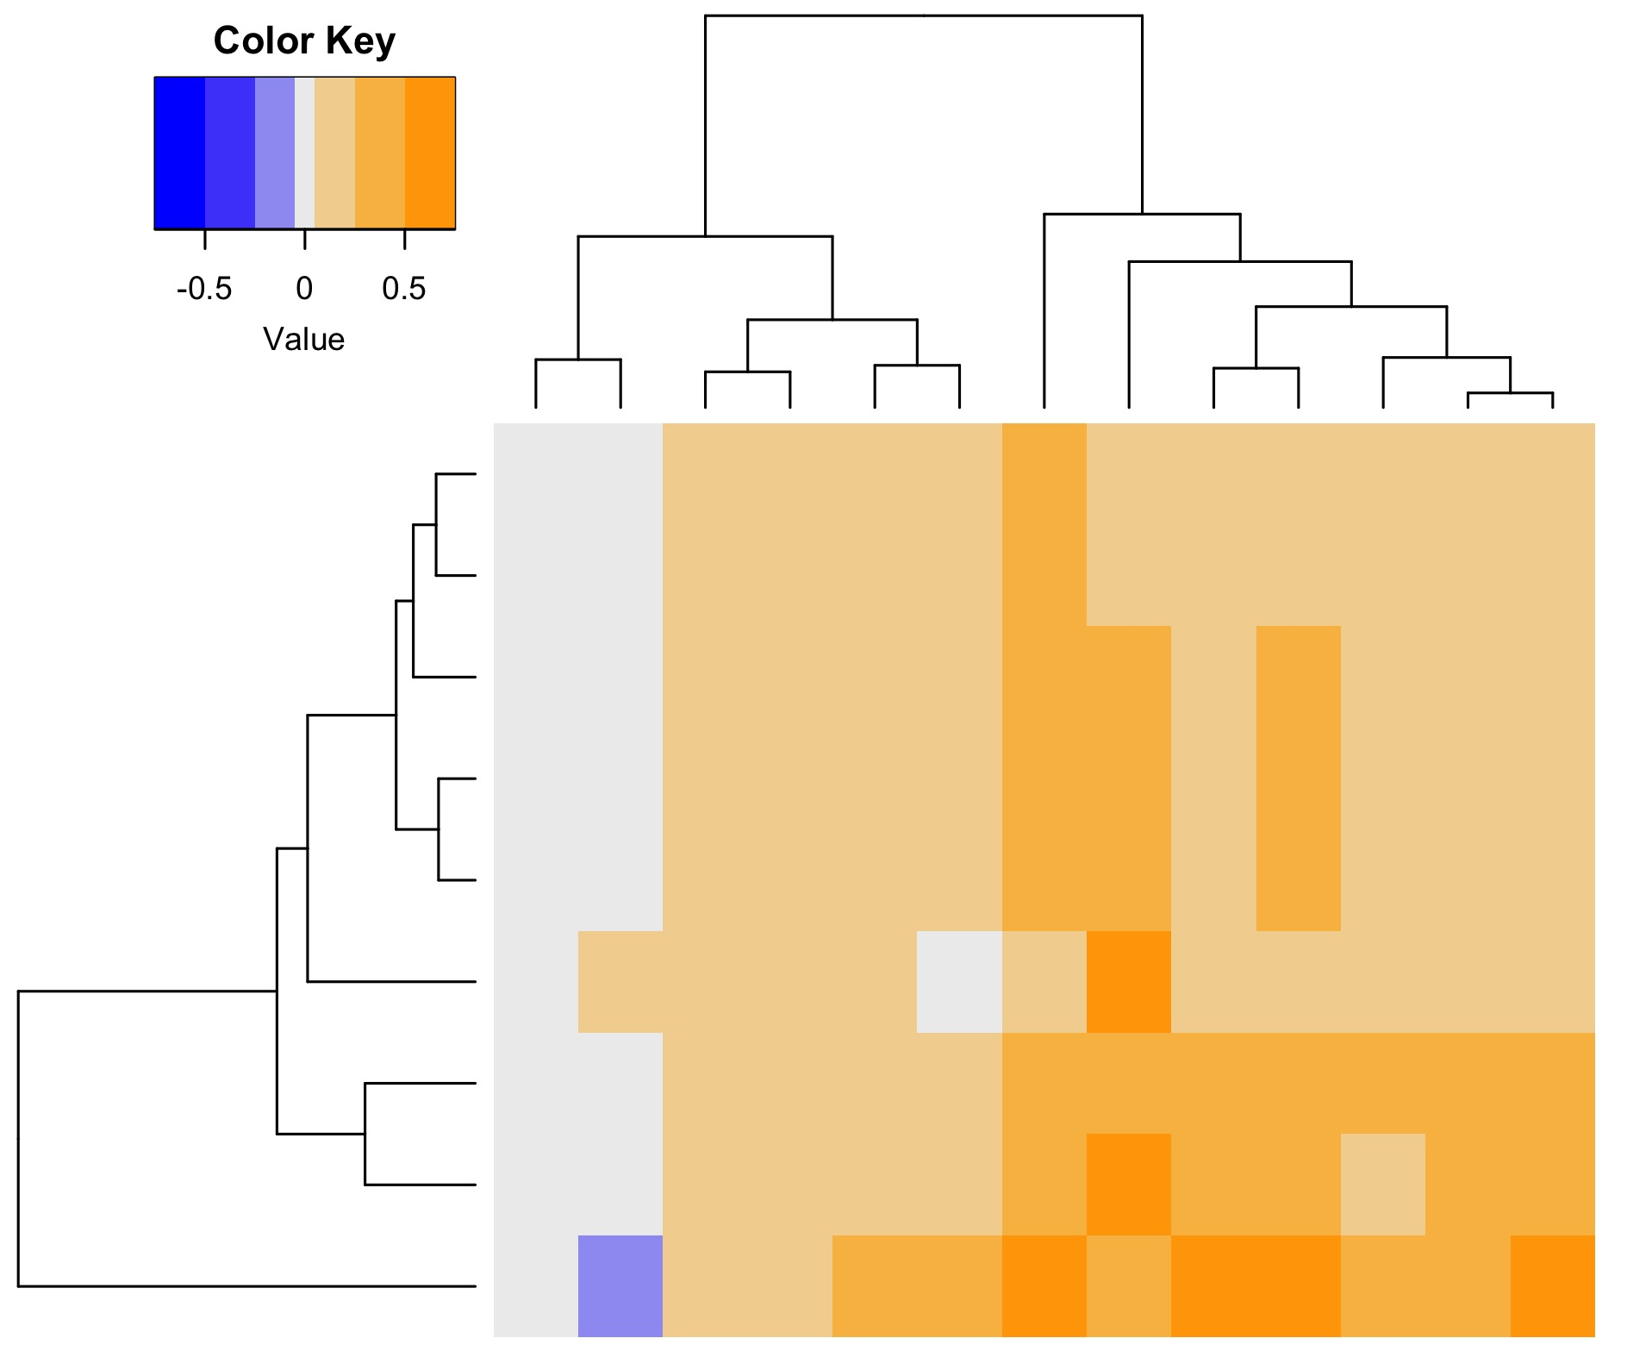
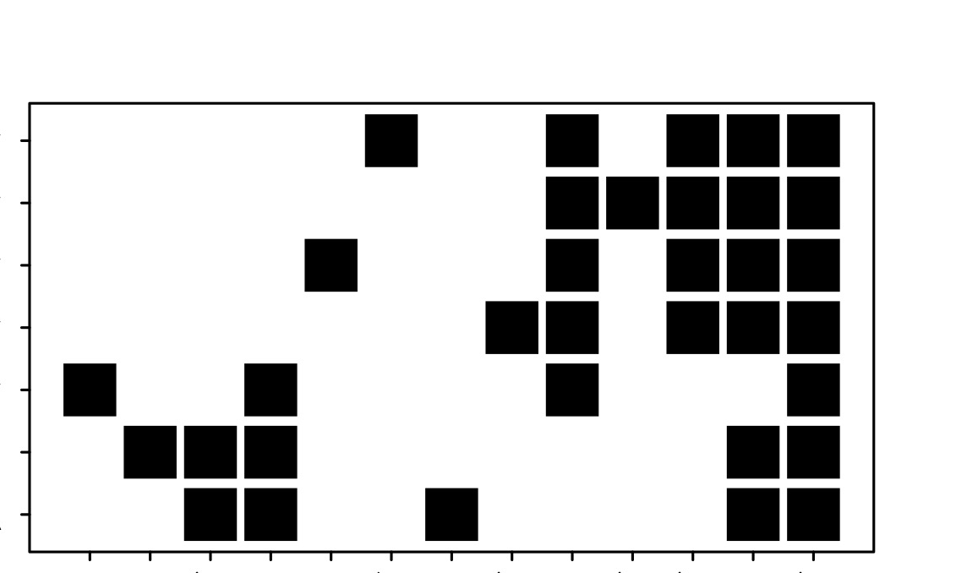
How sensitive are BKC adult outcomes to uncertain links?
Change in %
BKC adult
positive outcomes
HA – RKC-J
HJ – BKC-BR
PO – RKC-L
HJ – HA
PO – BKC-L
HA – RKC-J
RKC-A – RKC-L
HJ – RKC-BR
RKC-A – BKC-A
50 to 75
25 to 50
5 to 25
-5 to 5
-25 to -5
Uncertain
link
Pacific cod
Halibut
Red King Crab
Trawl
Warming
OA
Fishing
effort
Pressed
nodes
BKC hatchery
Perturbation scenarios

Slide 27
How sensitive are outcomes to inequality information?
Probability of positive response of
Difference
Yes
No
Inequality
constraints?

Slide 28
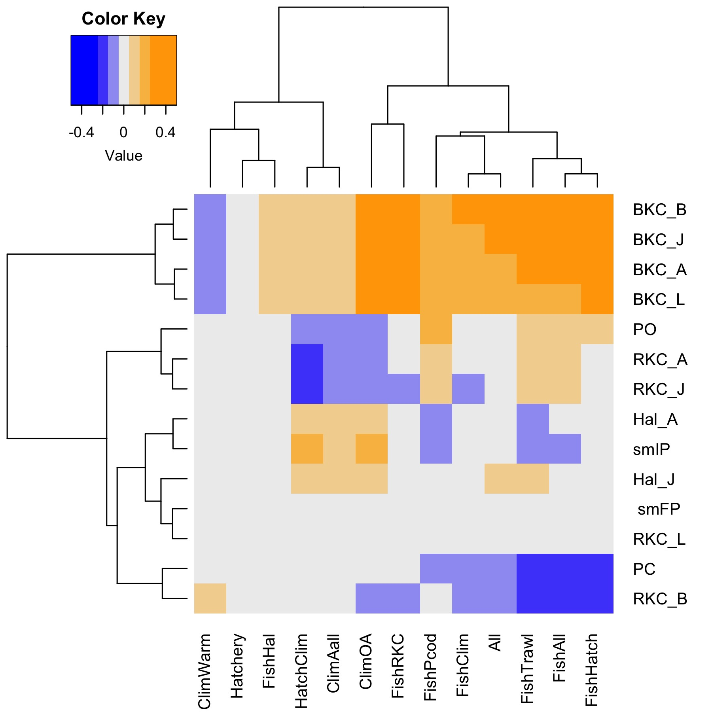
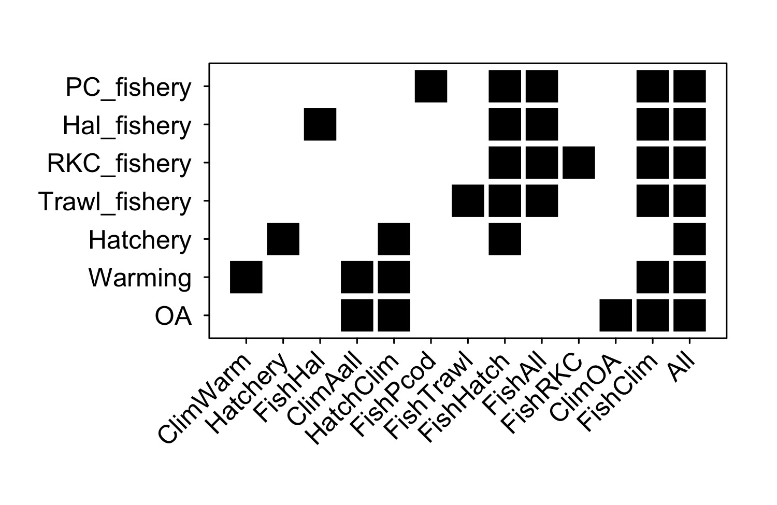
How sensitive are outcomes to inequality information?
BKC-BR
BKC-J
BKC-A
BKC-L
Pollock
RKC-A
RKC-J
Halibut-A
Invert predators
Halibut-J
Fish predators
RKC-L
Pacific Cod
RKC-BR
Change in %
positive outcomes
25 to 50
15 to 25
5 to 15
0
-15 to -5
-25 to -15
-50 to -25
Community
nodes
Pacific cod
Halibut
Red King Crab
Trawl
Warming
OA
Fishing
effort
Pressed
Nodes
BKC outstocking
Perturbation scenarios

Slide 30
What can we do?
Ecological
interactions
Management
levers
Social/
economic
Climate
impacts
Guide research
Adaptable
Big picture

Slide 31
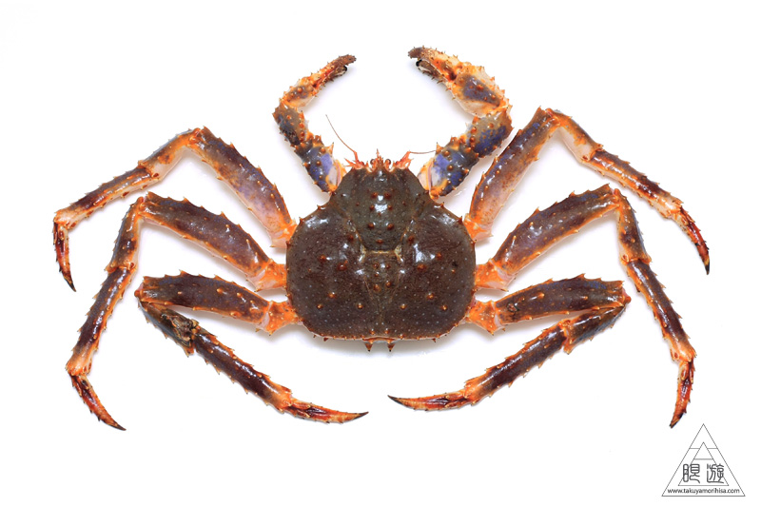

Acknowledgements
Workshop participants from:
  Aleut Community of St. Paul Island - Ecosystem Conservation Office
  Aleutian Pribilof Islands Association
  Aleutian Pribilof Islands Community Development Association
  Alaska Maritime National Wildlife Refuge
  Alaska Bering Sea Crabbers Association
  Alaska Longline Fishermen’s Association
  At Sea Processors Association
  City of St. Paul
  Central Bering Sea Fishermen’s Association
  Tanadgusix Corporation
  Alaska Department of Fish and Game
  University of Alaska Fairbanks
  NOAA
North Pacific Research Board (Project #1609)

Slide 32
Socioecological model in corporate management system? Look at knock on effects in the social system/human community. Link management to local communities.
Develop testable hypotheses?
Future directions
Si, se puede!
Use in other systems, used in management context. CSIRO – Dambacher.

